Slide 1
Duckietown Presentation
Tobias, Manjunath, Yifan

Slide 2
Autonomous Navigation & Real Time Mapping on iOS
System combining both of these things with output to the iOS mobile application
Empower users with a comprehensive understanding of a robot's movements in real-time, even in uncharted territories
Intuitive iOS application that offers both utility and insight into autonomous robotic navigation, as well as key information about the robot itself.
1. Lane Following
2. Trajectory & Analysis
3. iOS Mobile Application

Slide 3
Midterm: Project Outline
Step 2: Calibration
Wheels
Camera
Lane following Duck
Step 3: Project Definition
Lane following Demo
Mobile App with track layout
Step 1: Assembly
& Software Setup

Slide 4
Midterm: Project Outline
Step 5.1: Dynamic mapping system
Step 6.1: Map creation
Step 4: Basic Functionality
Wheel Control
Camera Control
Step 6.2: Lane following optimization
Step 5.2: Lane detection
FInal Presentation
Step 8:Optimization & error handling
Step 7: Autonomous mapping System

Slide 5
AprilTags & Lane Following

Slide 6
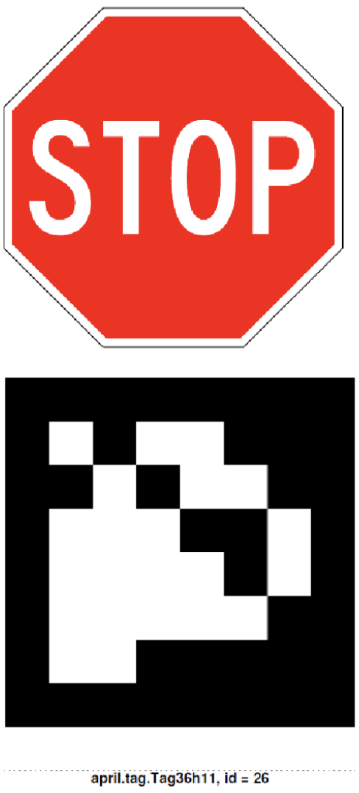
AprilTags
AprilTags are binary markers designed for easy detection and robust identification by computer vision algorithms.
They offer precise localization capabilities, crucial for tasks like navigation, object tracking, and augmented reality applications
Small payload: 4-12 bits of data
Easy detection and robust identification
Long-range detectability

Slide 7
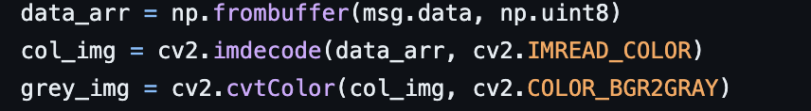

AprilTag detection
These are detected using Computer vision libraries like OpenCV.
After converting to grey_img we can detect tag using apriltag.detector() in dt-apriltag.
Notes:
This array likely contains the image data coming from the camera.

Slide 8
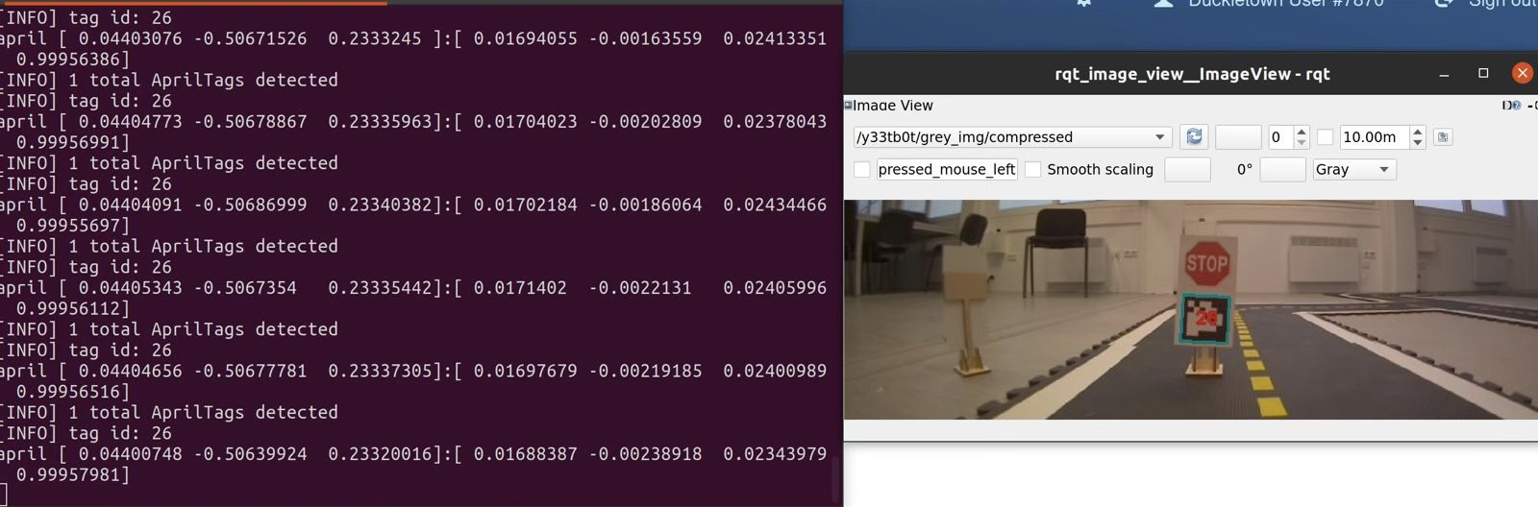
AprilTag Detection:

Slide 9

Integrating AprilTags detection and LED lights.
Duckiebot recognising different AprilTags by exhibiting to different colours of LED lights.

Slide 10
Lane Following
Notes:
It plays a crucial role in ensuring safe and efficient transportation, reducing accidents and congestion.

Slide 11
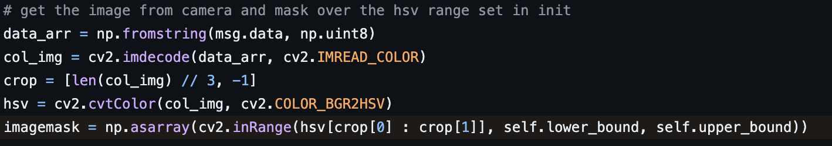

Implementation
This OpenCV code captures a camera image, converts it to HSV for color filtering, and creates a mask to isolate a yellow color.
After this, we find all the yellow dotted lines used to follow the lane.

Slide 12
PID Controller
The error equation in the controller:
error=( x + sizeratio × y − goal ) × pixelscale
x = the left most side of the closest dotted line
y = the top of the closest dotted line divided by two
sizeratio = distance from centre of duckiebot to dotted line.This addresses the vanishing point problem.
goal = where the bot wants to be. Represented by a blue vertical line in the image
pixelscale = scales the error down to account for a large error in pixels relative to a small error in angle

Slide 13
Lane Following

Slide 14
Trajectory Generation and Analysis

Slide 15
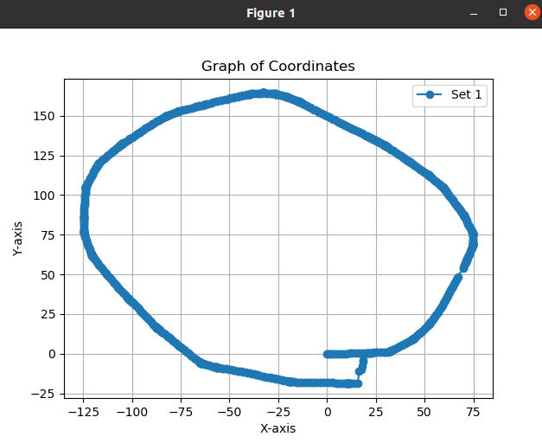
Trajectory Generation and Analysis
Wheel encoder data to estimate Duckiebot trajectory
Analyse the movement patterns on a track
Primary goal: coordinates of the robot's position
Mapping location on a coordinate system using an “Elementary Trajectory Model for the Differential Steering System”

Slide 16
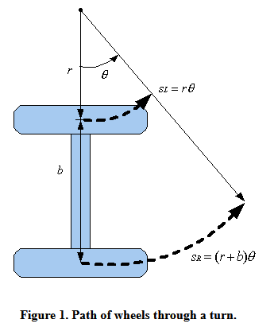
Calculation of Coordinates
Theory behind it is pretty simple:
Subscribe to wheel encoders
Calculate the change in values to the previous moment in time
Keep a direction value at each point in time and update it every time encoders change
Calculate the coordinates based on distance traveled per wheel, orientation, wheel distance & wheel radius

Slide 17
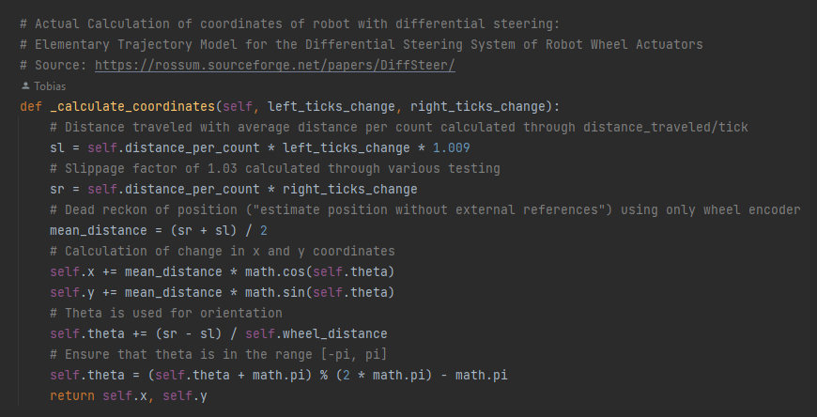
Calculation of Coordinates
Code Snippet

Slide 18
Calculation of Coordinates
Challenges
Things needed to consider:
Encoders are not 100% reliable
The Duckiebot tends to move a bit to the left when supposed to only go straight
Extremly Quick changes might not be as accurate
Because of big challenges in the beginning we tried out Slam, which did not improve the situation

Slide 19
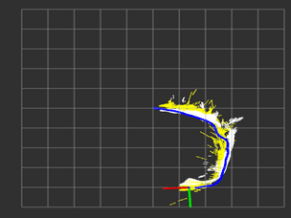
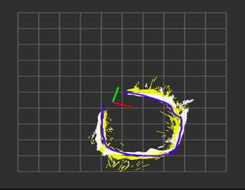
Midterm Review:
Objective: Dynamic mapping system
Real Time perception
Active perception of driving course
Iterative construction of the map
Construction of living, dynamic map of Duckietown
Usage of BFS or DFS traversal to find all “nodes” of the map

Slide 20
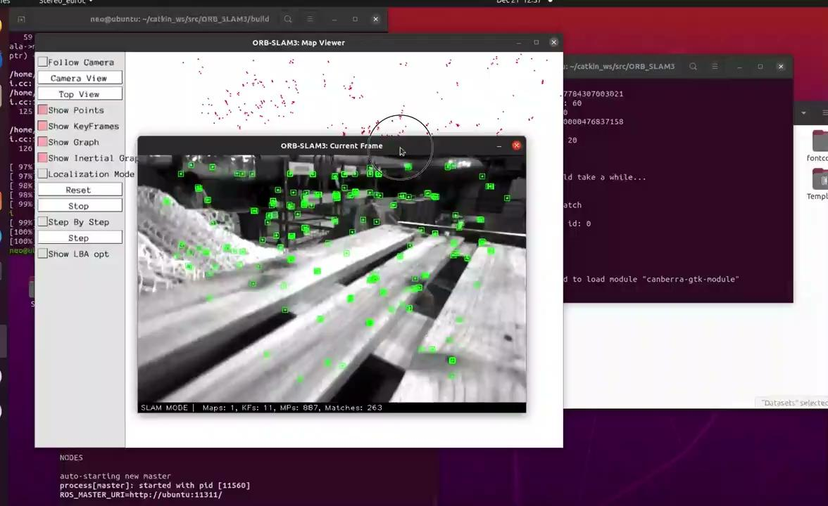
Slam Orb
Midterm Review:
Dynamic Map

Slide 21
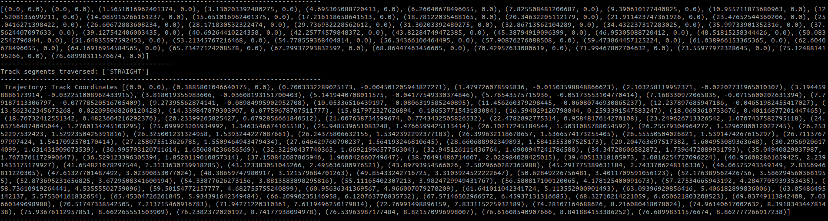
Calculation of Coordinates
Output

Slide 22


Analyzation of Track Types
Output
Track Types can be analysed:
Straights
Left Curves
No movement
Posted as a sequence of Tracks that have the Duckiebot travelled

Slide 23
Analyzation of Track Types
How does it work?
How does it work:
Absolute degree of the slope between the start and end coordinates of the track the bot has just crossed
Simulates the direction of movement using the orientation value at the end and start point
Special attention has to be paid here to the calculation of the slope → depends on the orientation value ‘theta’: North sout or west east movement

Slide 24
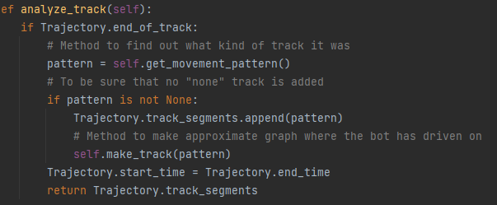
Code Snippet

Slide 25
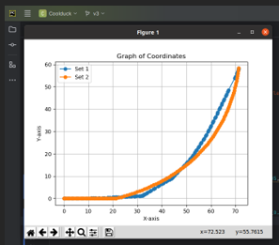
Simulation of the Track
Simulation of the Track just passed using Bezier Curve and Linear Modelling
Defines the track the bot drived on

Slide 26
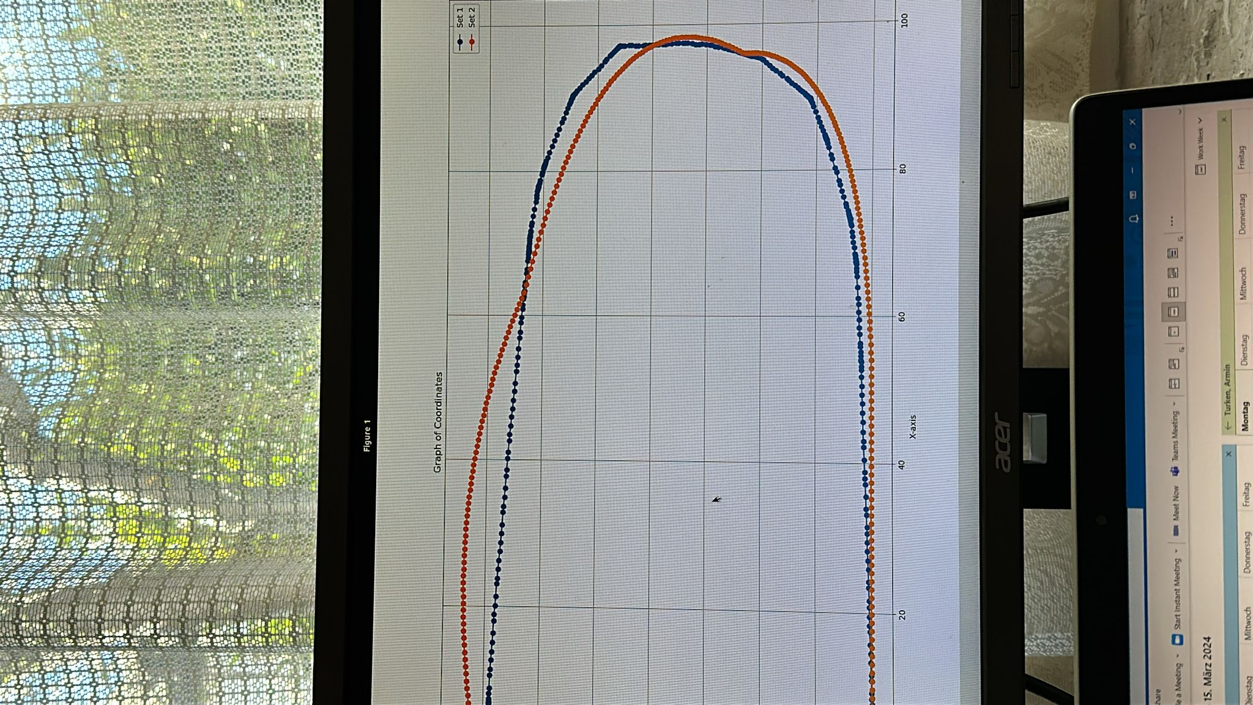
Simulation of the Track

Slide 27
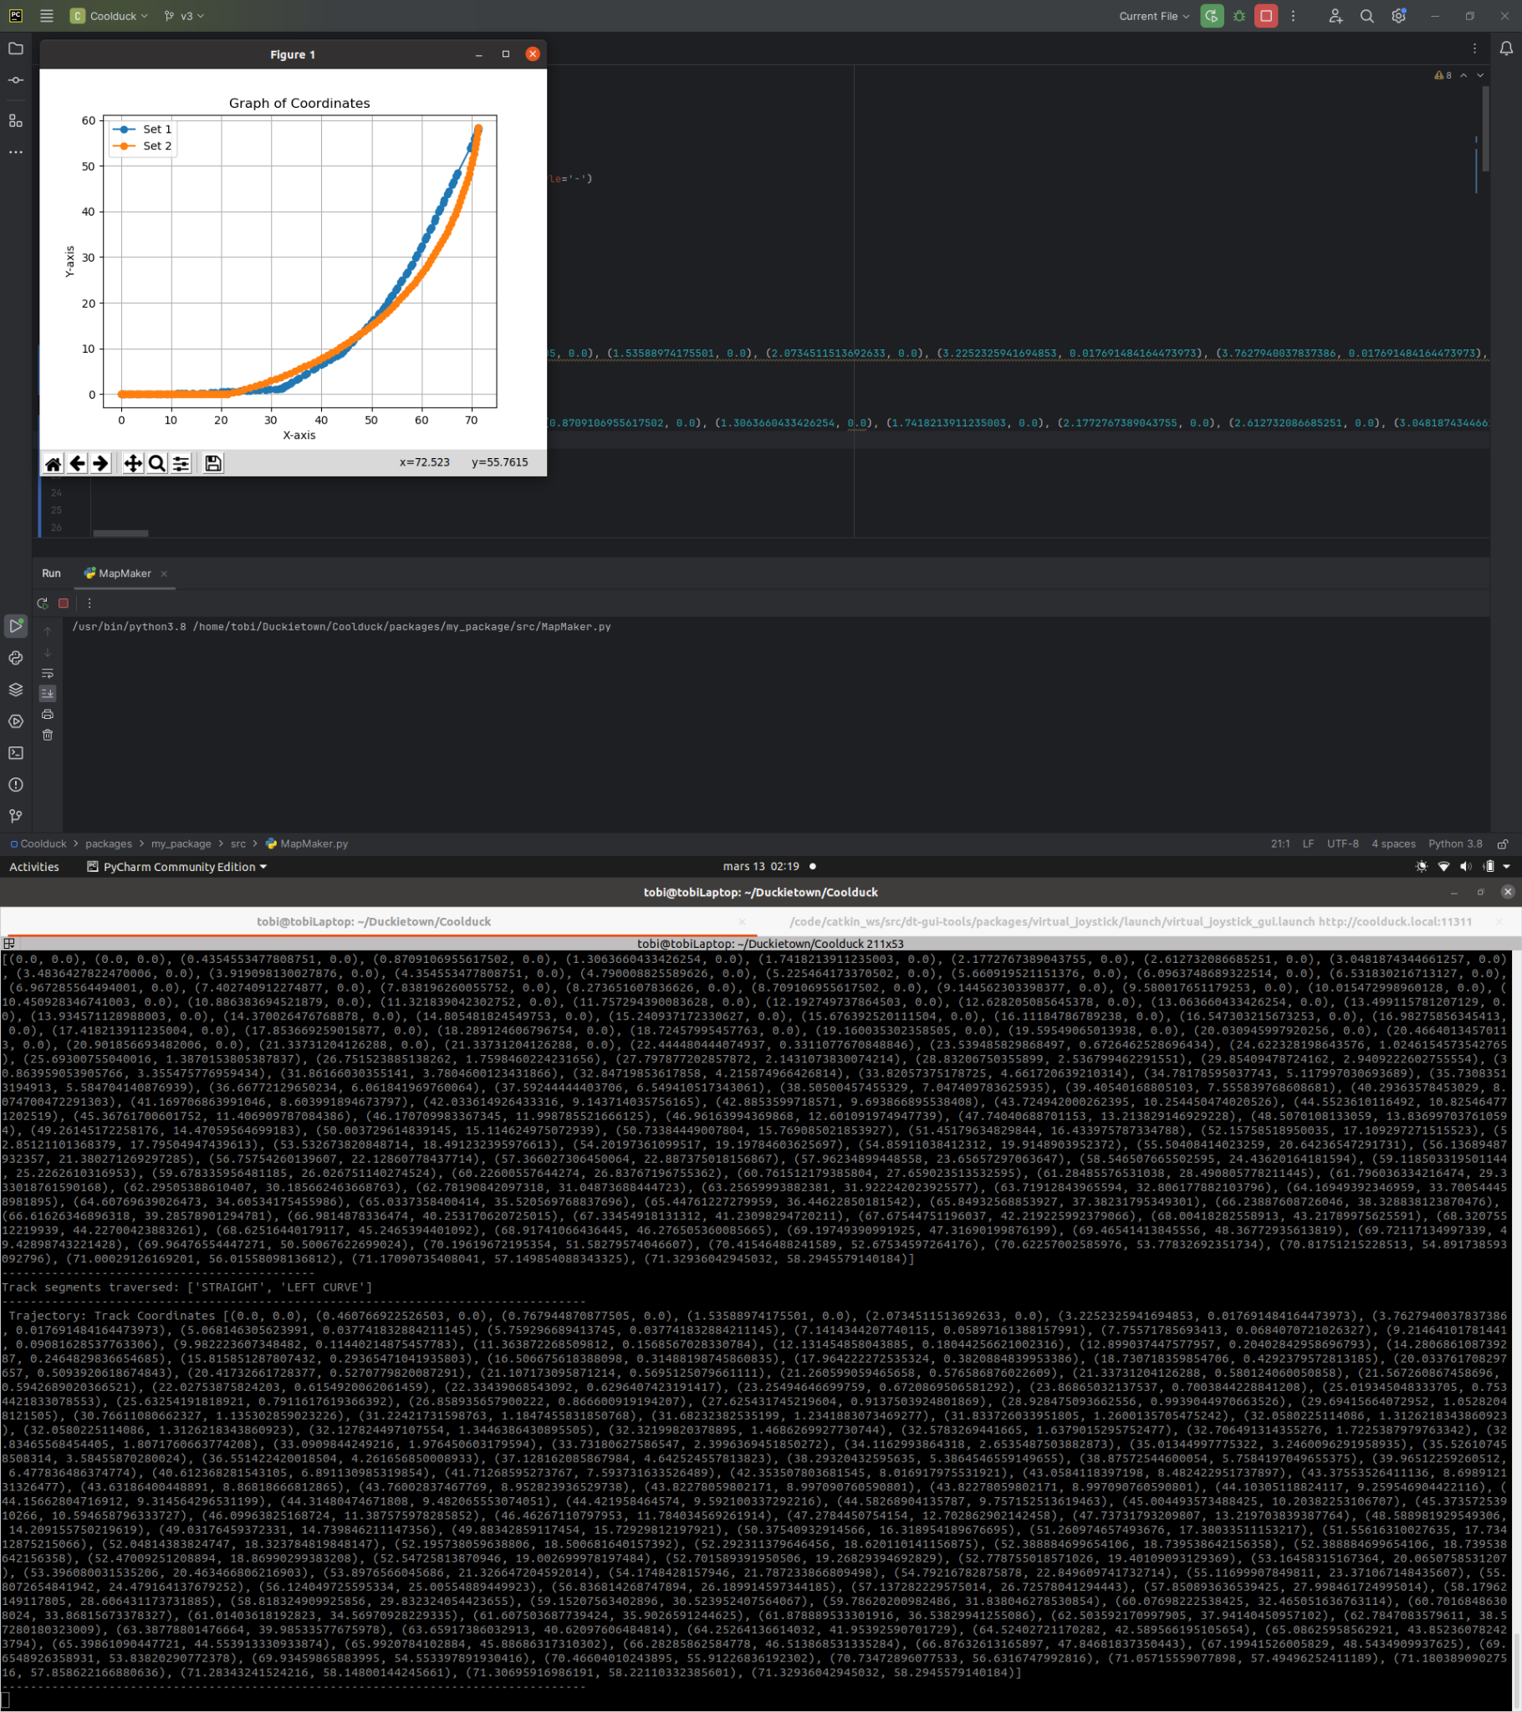
Simulation in action

Slide 28
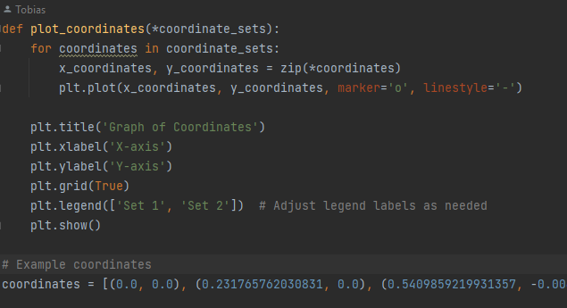
Visualization
Visualisation either in Map_Maker Script in Project or on iOS
Publisher in the Trajectory class publishes a message as a string containing the trajectory coordinates and the simulated trajectory coordinates every time the run method runs (at a frequency of 20Hz).

Slide 29
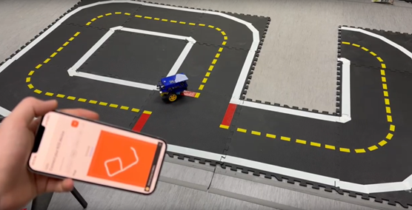
Visualisation of Trajectory in real time

Slide 30
iOS Application

Slide 31
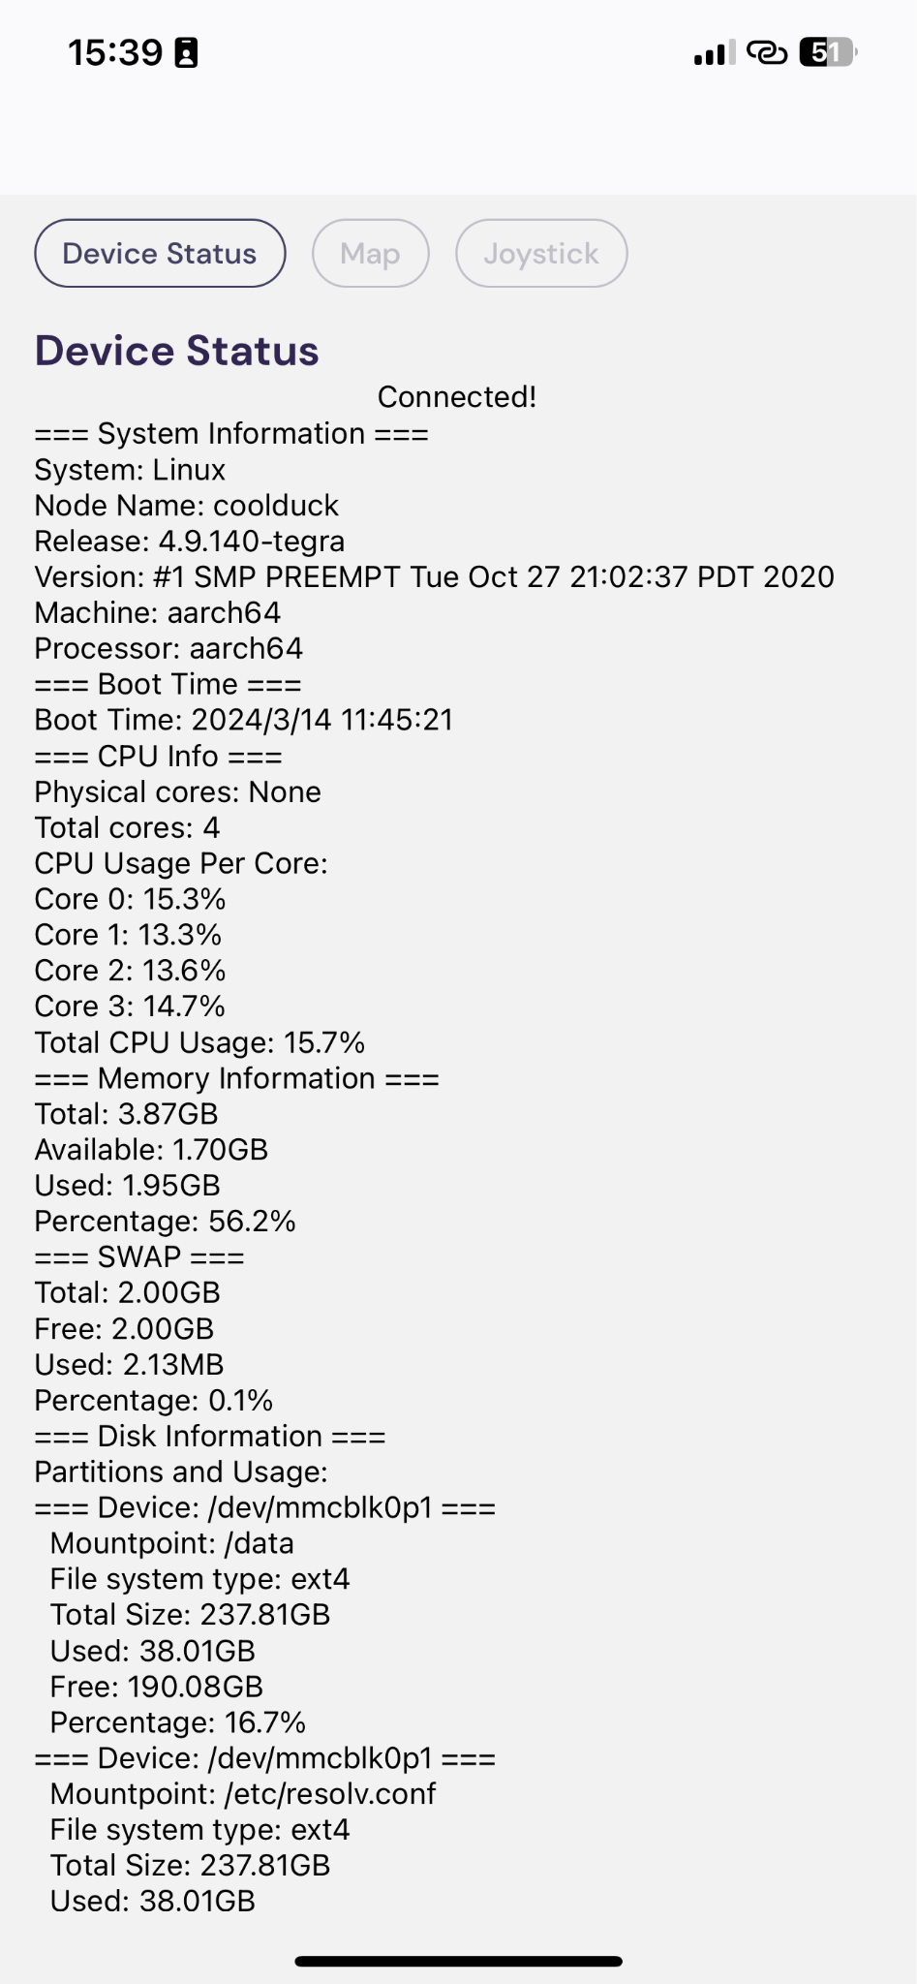
Mobile ROS - an iOS
application for robots
Device status fetching
all information in one
customizable
expandable to other application (explain later)

Slide 32
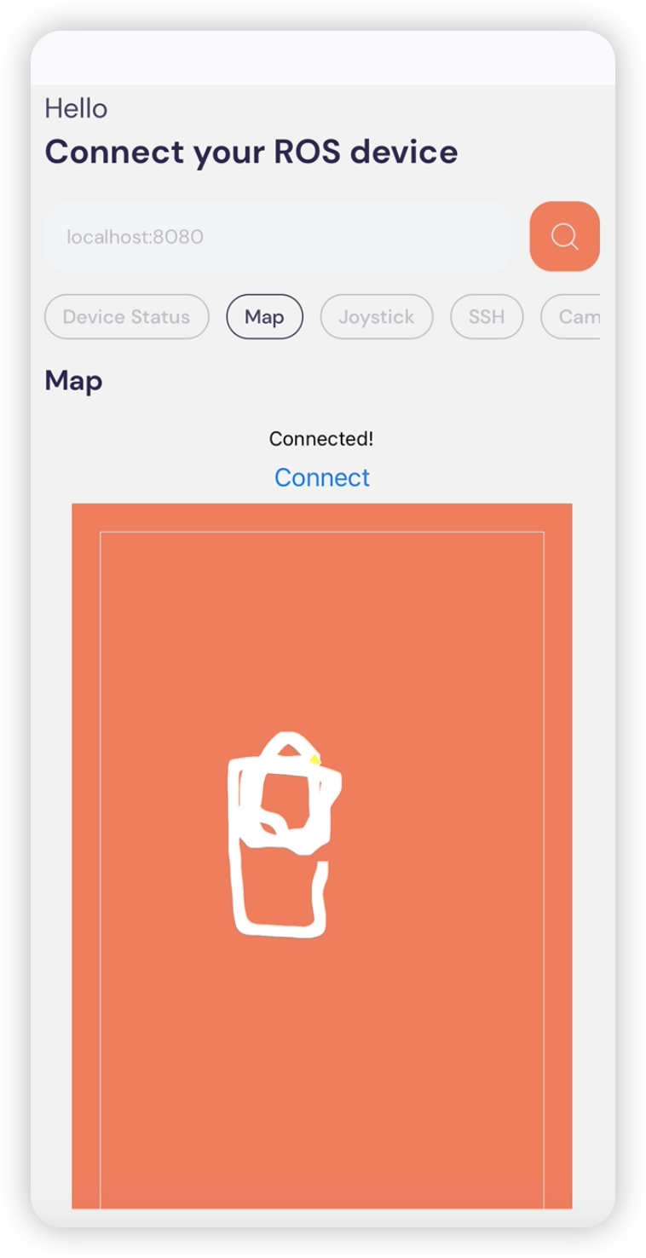
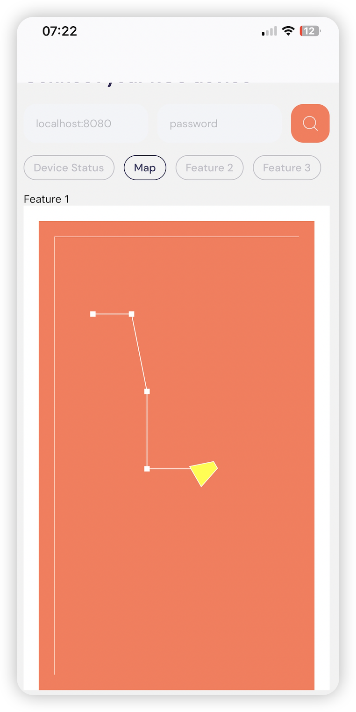
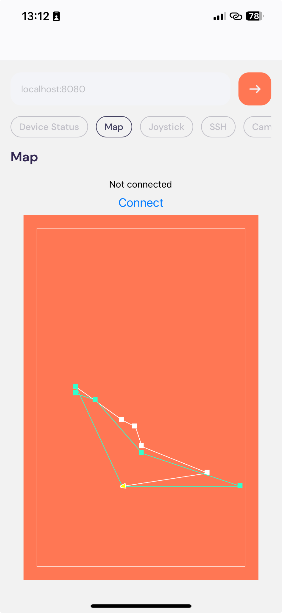
Mobile ROS - an iOS application for robots

Slide 33

Mobile ROS - an iOS
application for robots
Control with your mobile
force sensing
subtle control
easy to use

Slide 34
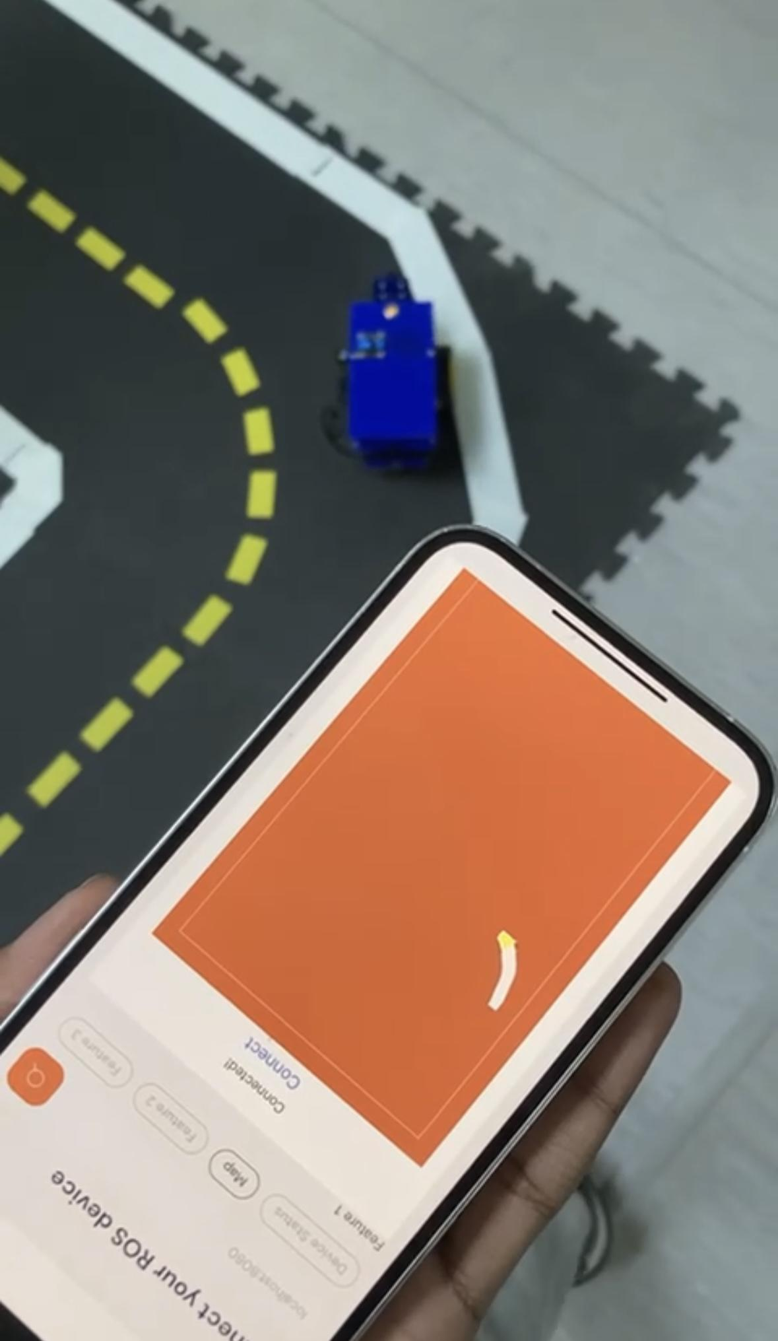
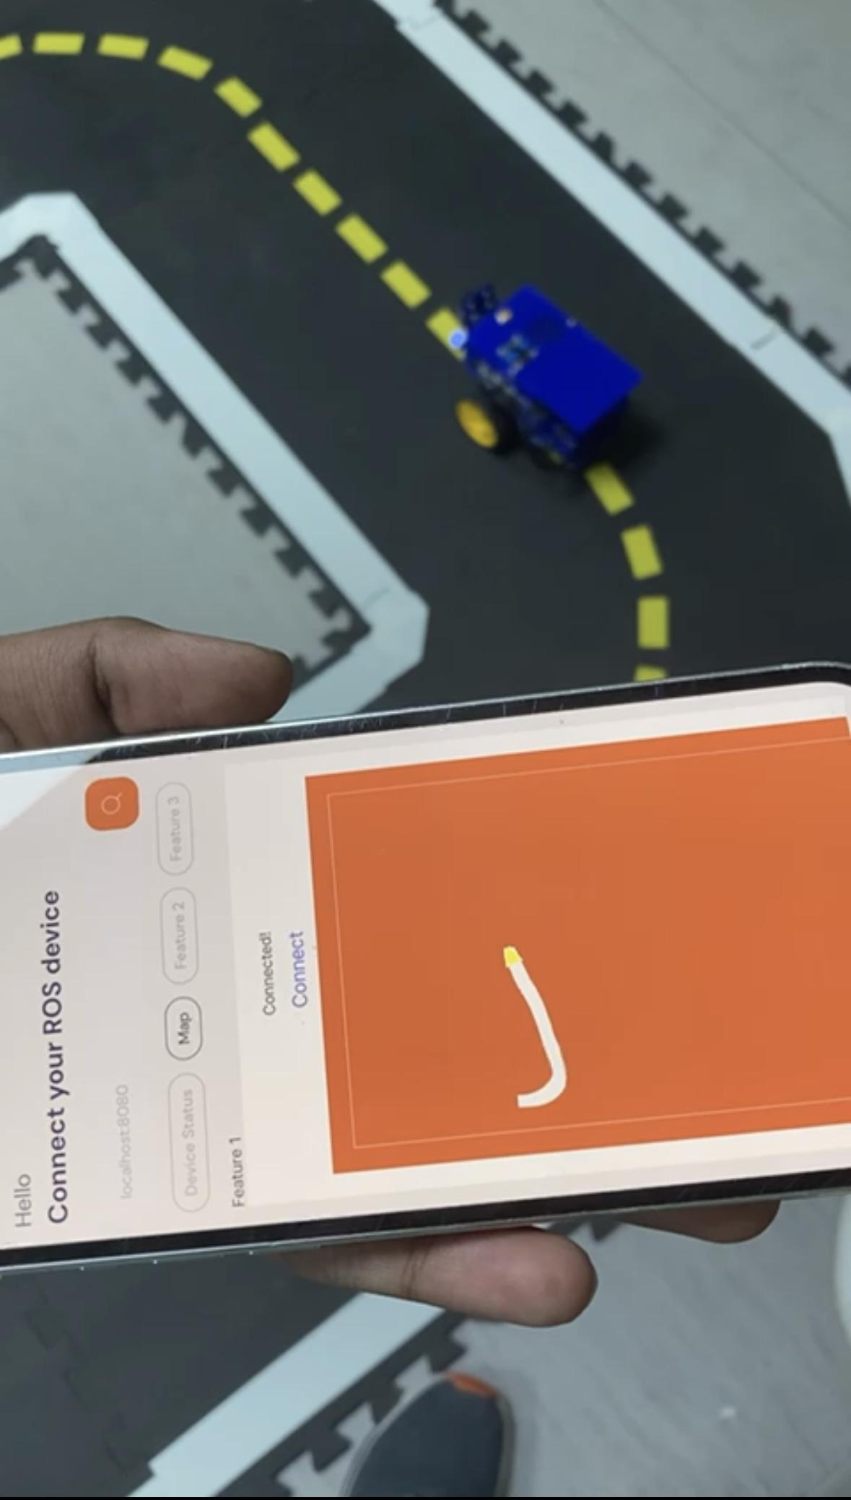
iOS Mobile Application in action

Slide 35
Demo Video 1
Basic Track: https://youtu.be/SlGvRx_gKrY

Slide 36
Demo Video 2
Advanced Track: https://youtu.be/PKKq_eWwhZE

Slide 37
Demo Video 3
End-Level Track https://youtu.be/yZKdoTJIhHA

Slide 38
Thank you

Slide 39
Bibliography
Works Cited
“Beginner - Code Hierarchy — Book-Devmanual-Software - Daffy.” Docs.duckietown.com, docs.duckietown.com/daffy/devmanual-software/beginner/code-hierarchy/index.html. Accessed 13 Mar. 2024. priority_high Webpage author
priority_high Date published
“Bezier.curve Module — Bezier 2023.7.28 Documentation.” Bezier.readthedocs.io, bezier.readthedocs.io/en/stable/python/reference/bezier.curve.html. Accessed 13 Mar. 2024. priority_high Webpage author
priority_high Date published
“Exercise 3.” Ekhumbata.github.io, ekhumbata.github.io/Adventures-in-Duckietown/exercise3.html. Accessed 14 Mar. 2024. priority_high Webpage author
priority_high Date published
“Golnaz Mesbahi - Lab 3.” Github.io, 2023, golnazmes.github.io/Lab%203.html. Accessed 14 Mar. 2024. priority_high Webpage author
“How to Generate Random Points in a Line.” De.mathworks.com, de.mathworks.com/matlabcentral/answers/175107-how-to-generate-random-points-in-a-line?s_tid=prof_contriblnk. Accessed 13 Mar. 2024. priority_high Webpage author
priority_high Date published
“Isarlab-Department-Engineering/Ros_dt_lane_follower.” GitHub, 21 Nov. 2023, github.com/isarlab-department-engineering/ros_dt_lane_follower. Accessed 14 Mar. 2024. priority_high Webpage author
“Lane Following Robot Using OpenCV.” Hackster.io, www.hackster.io/Aasai/lane-following-robot-using-opencv-da3d45. priority_high Webpage author
priority_high Date published
Mazur, Izabela, and Kim Moshenko. “3.4 Understand Slope of a Line – Optional.” Opentextbc.ca, 8 Sept. 2021, opentextbc.ca/businesstechnicalmath/chapter/understand-slope-of-a-line-2/. Accessed 13 Mar. 2024. priority_high Volume number
priority_high Issue number
“New ROS DTProject — Book-Devmanual-Software - Daffy.” Docs.duckietown.com, docs.duckietown.com/daffy/devmanual-software/beginner/ros/create-project.html. Accessed 12 Mar. 2024. priority_high Webpage author
priority_high Date published
Project , Rossum. “A Tutorial and Elementary Trajectory Model for the Differential Steering System.” Rossum.sourceforge.net, rossum.sourceforge.net/papers/DiffSteer/. priority_high Date published
“Publish Chassis-Level Commands — Book-Devmanual-Software - Daffy.” Docs.duckietown.com, docs.duckietown.com/daffy/devmanual-software/beginner/ros/twist-control.html. Accessed 13 Mar. 2024. priority_high Webpage author
priority_high Date published
“Publish to Wheels — Book-Devmanual-Software - Daffy.” Docs.duckietown.com, docs.duckietown.com/daffy/devmanual-software/beginner/ros/wheel-control.html. Accessed 13 Mar. 2024. priority_high Webpage author
priority_high Date published
Rosebrock, Adrian. “AprilTag with Python.” PyImageSearch, 2 Nov. 2020, pyimagesearch.com/2020/11/02/apriltag-with-python/.
Samiei, Mandana. “Mandanasmi/Lane-Slam.” GitHub, 3 Feb. 2024, github.com/mandanasmi/lane-slam. Accessed 14 Mar. 2024.
“Subscribe to Wheel Encoders — Book-Devmanual-Software - Daffy.” Docs.duckietown.com, docs.duckietown.com/daffy/devmanual-software/beginner/ros/wheel-encoder-reader.html. Accessed 12 Mar. 2024. priority_high Webpage author
priority_high Date published
“What Is Difference between Rospy.spin() and While Not Rospy.is_shutdown()?” The Construct ROS Community, 2 Jan. 2020, get-help.theconstruct.ai/t/what-is-difference-between-rospy-spin-and-while-not-rospy-is-shutdown/1849. Accessed 12 Mar. 2024. priority_high Webpage author
“Beginner - Code Hierarchy — Book-Devmanual-Software - Daffy.” Docs.duckietown.com, docs.duckietown.com/daffy/devmanual-software/beginner/code-hierarchy/index.html. Accessed 13 Mar. 2024.
“Bezier.curve Module — Bezier 2023.7.28 Documentation.” Bezier.readthedocs.io, bezier.readthedocs.io/en/stable/python/reference/bezier.curve.html. Accessed 13 Mar. 2024.
“Exercise 3.” Ekhumbata.github.io, ekhumbata.github.io/Adventures-in-Duckietown/exercise3.html. Accessed 14 Mar. 2024.
“Golnaz Mesbahi - Lab 3.” Github.io, 2023, golnazmes.github.io/Lab%203.html. Accessed 14 Mar. 2024.
“How to Generate Random Points in a Line.” De.mathworks.com, de.mathworks.com/matlabcentral/answers/175107-how-to-generate-random-points-in-a-line?s_tid=prof_contriblnk. Accessed 13 Mar. 2024.
“Isarlab-Department-Engineering/Ros_dt_lane_follower.” GitHub, 21 Nov. 2023, github.com/isarlab-department-engineering/ros_dt_lane_follower. Accessed 14 Mar. 2024.
“Lane Following Robot Using OpenCV.” Hackster.io, www.hackster.io/Aasai/lane-following-robot-using-opencv-da3d45.
Mazur, Izabela, and Kim Moshenko. “3.4 Understand Slope of a Line – Optional.” Opentextbc.ca, 8 Sept. 2021, opentextbc.ca/businesstechnicalmath/chapter/understand-slope-of-a-line-2/. Accessed 13 Mar. 2024.
“New ROS DTProject — Book-Devmanual-Software - Daffy.” Docs.duckietown.com, docs.duckietown.com/daffy/devmanual-software/beginner/ros/create-project.html. Accessed 12 Mar. 2024.
Project , Rossum. “A Tutorial and Elementary Trajectory Model for the Differential Steering System.” Rossum.sourceforge.net, rossum.sourceforge.net/papers/DiffSteer/.
“Publish Chassis-Level Commands — Book-Devmanual-Software - Daffy.” Docs.duckietown.com, docs.duckietown.com/daffy/devmanual-software/beginner/ros/twist-control.html. Accessed 13 Mar. 2024.
“Publish to Wheels — Book-Devmanual-Software - Daffy.” Docs.duckietown.com, docs.duckietown.com/daffy/devmanual-software/beginner/ros/wheel-control.html. Accessed 13 Mar. 2024.
Rosebrock, Adrian. “AprilTag with Python.” PyImageSearch, 2 Nov. 2020, pyimagesearch.com/2020/11/02/apriltag-with-python/.
Samiei, Mandana. “Mandanasmi/Lane-Slam.” GitHub, 3 Feb. 2024, github.com/mandanasmi/lane-slam. Accessed 14 Mar. 2024.
“Subscribe to Wheel Encoders — Book-Devmanual-Software - Daffy.” Docs.duckietown.com, docs.duckietown.com/daffy/devmanual-software/beginner/ros/wheel-encoder-reader.html. Accessed 12 Mar. 2024.
“What Is Difference between Rospy.spin() and While Not Rospy.is_shutdown()?” The Construct ROS Community, 2 Jan. 2020, get-help.theconstruct.ai/t/what-is-difference-between-rospy-spin-and-while-not-rospy-is-shutdown/1849. Accessed 12 Mar. 2024.

